Slide 1
Detecting human body parts and Building Skeleton Models using Deep Convolutional Neural Networks

Slide 2
What I did
<number>
Read many articles
Tested multiple models and searched databases for training
Implemented a fully convolutional neural network for segmentation
Learned how to import pretrained models such as VGG, ResNet
Studied for a few weeks FasterRCNN, FastMaskRCNN and drew their schematics
Trained FastMaskRCNN for instance segmentation on COCO dataset
Trained FastMaskRCNN for body parts detection and segmentation
Modifying FastMaskRCNN for human detection and body parts segmentation

Slide 3
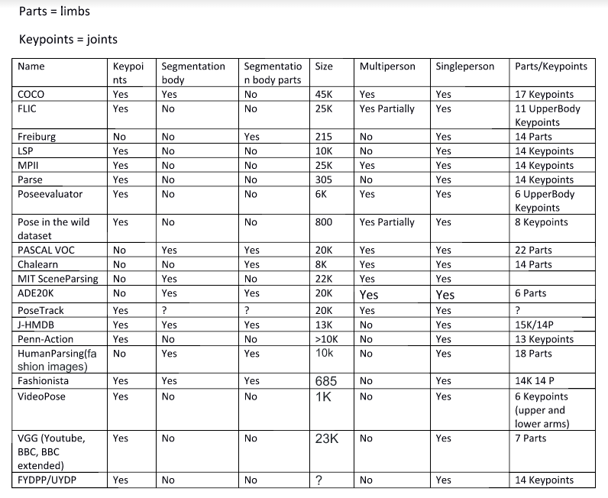
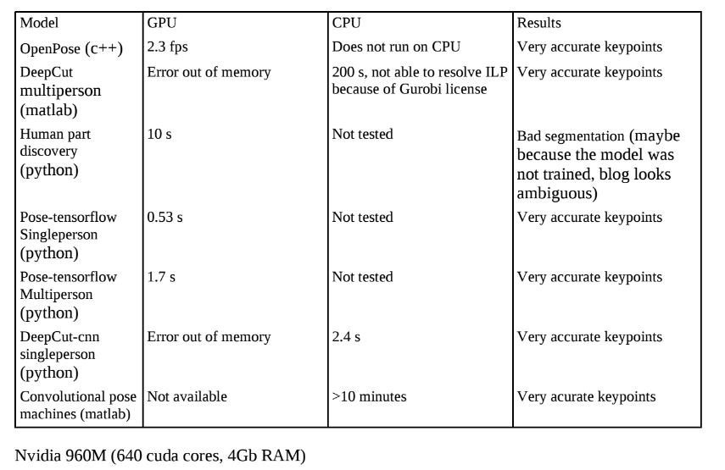
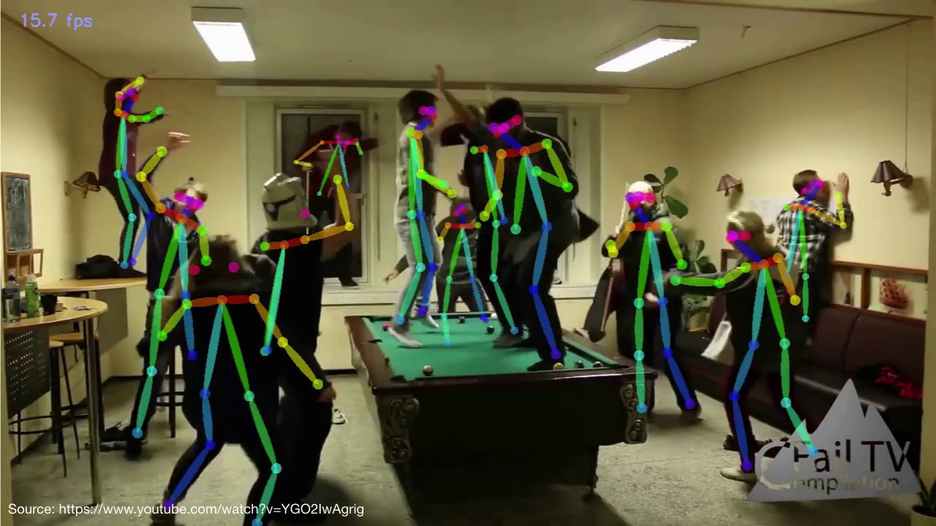
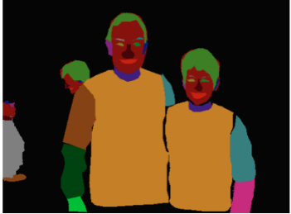
Articles, models and databases
<number>

Slide 4
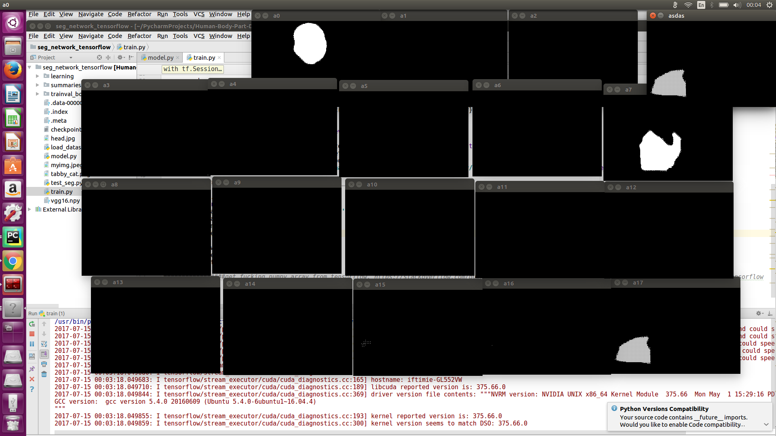
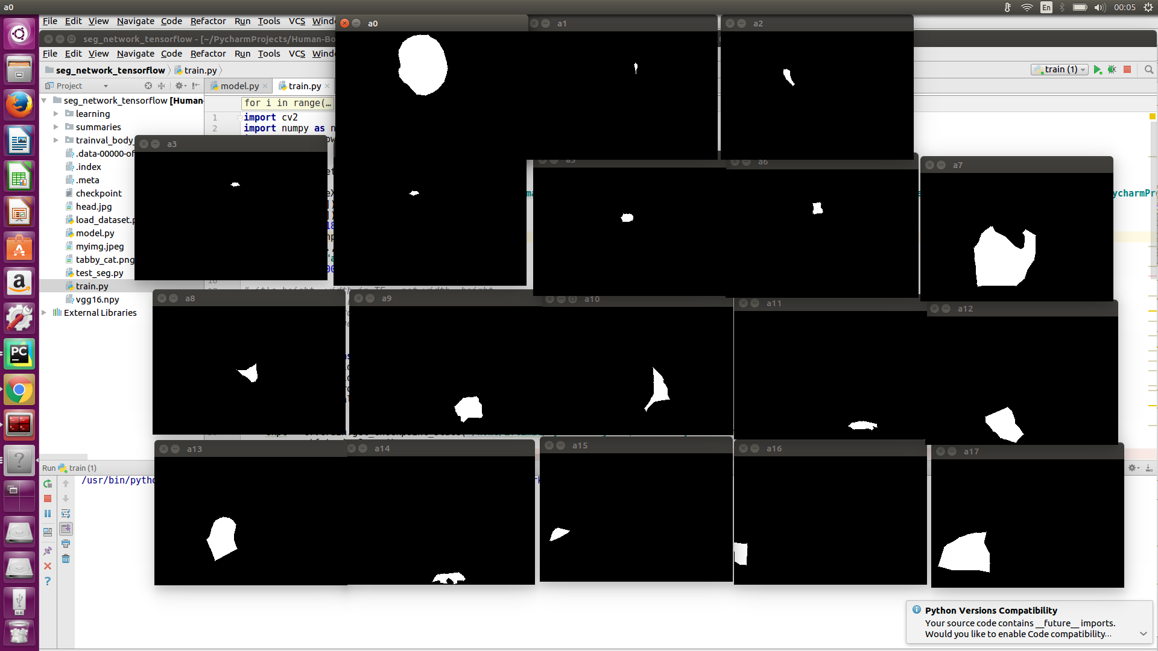
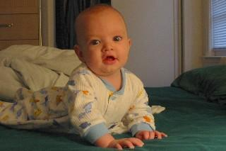
Implemented a fully convolutional neural network
<number>
Segmented
Ground truth

Slide 5
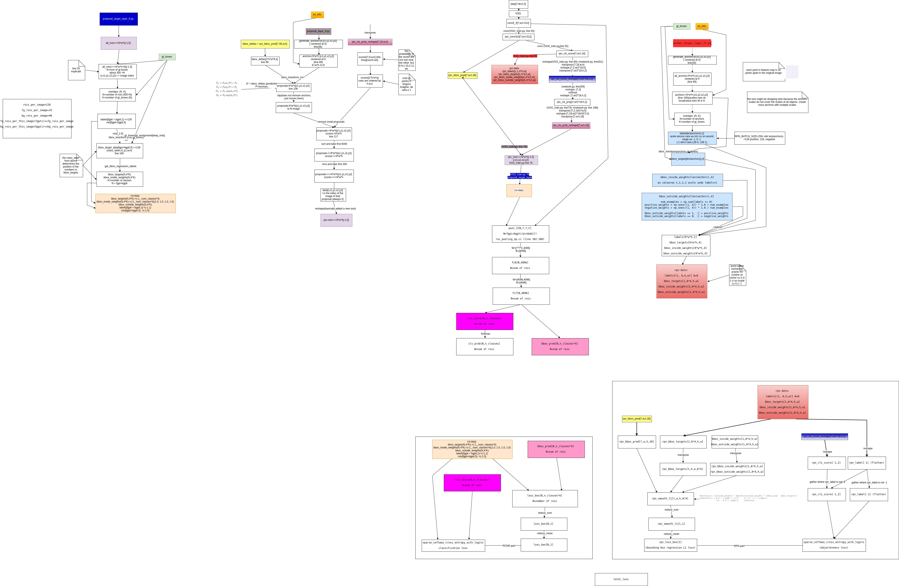
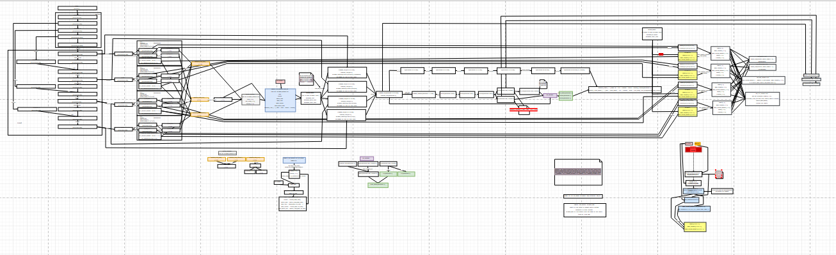
Studied for a few weeks FasterRCNN, FastMaskRCNN and drew their schematics given the Tensorflow code
<number>
FasterRCNN
FastMaskRCNN

Slide 6
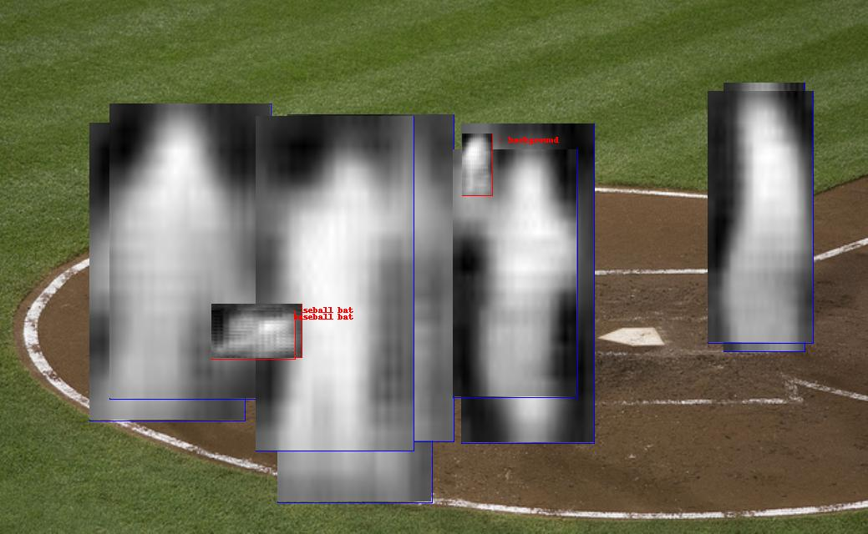
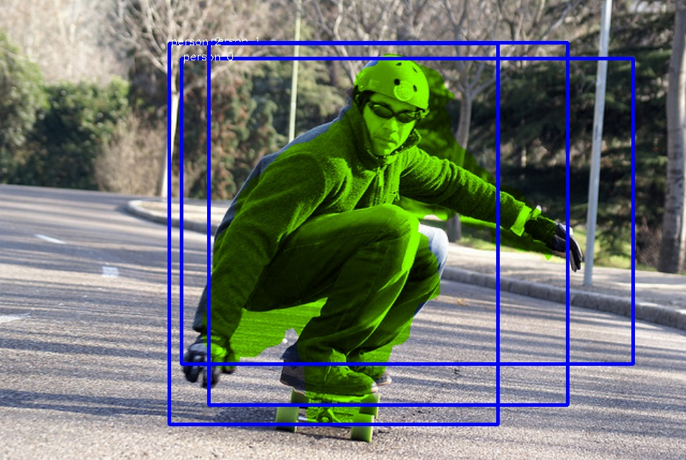

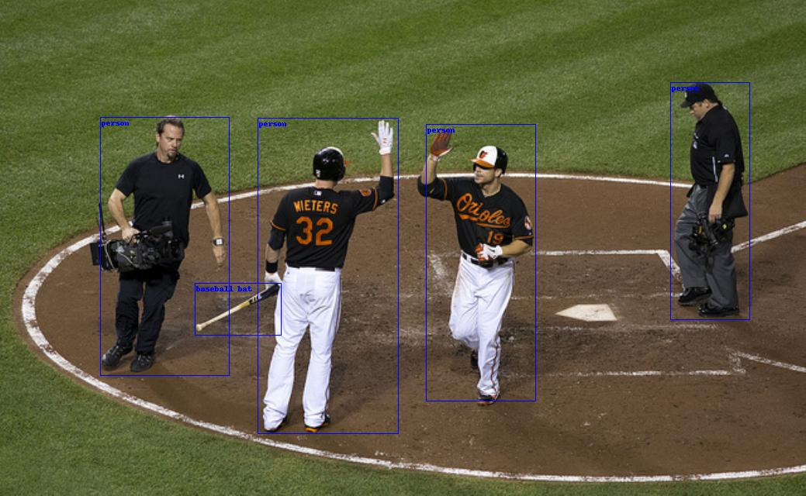
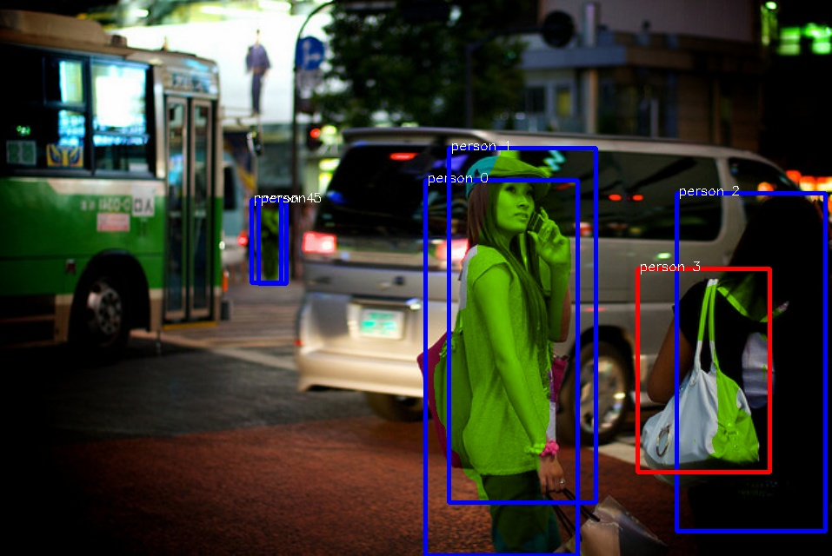
Trained FastMaskRCNN for instance segmentation on COCO dataset
<number>
<number>

Slide 7
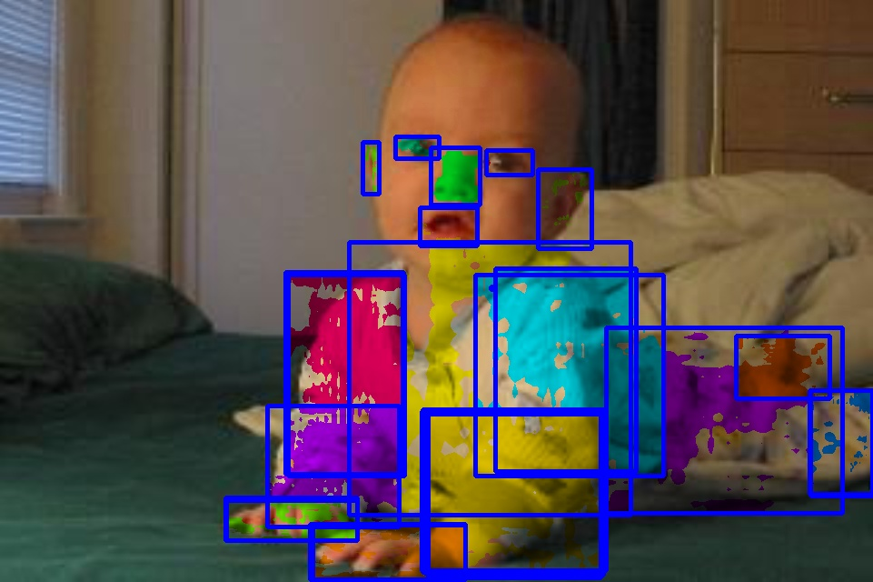
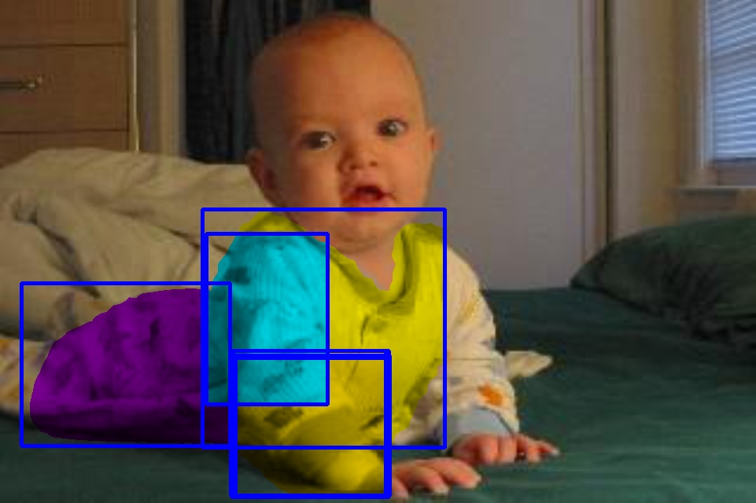
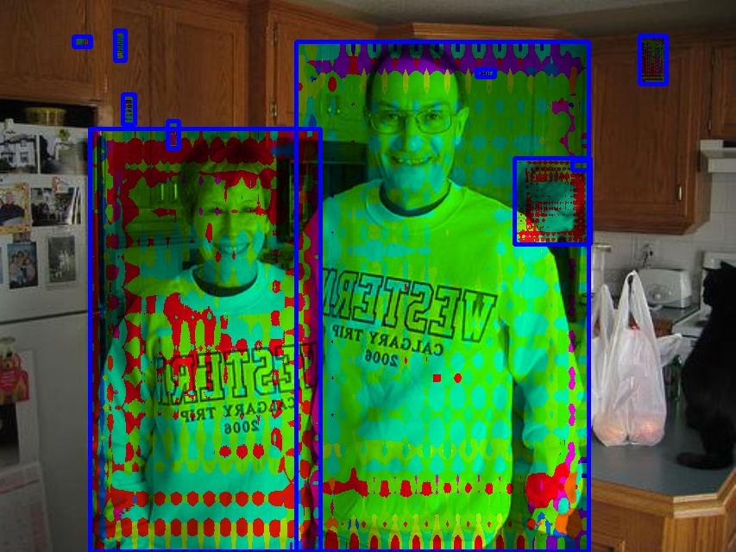
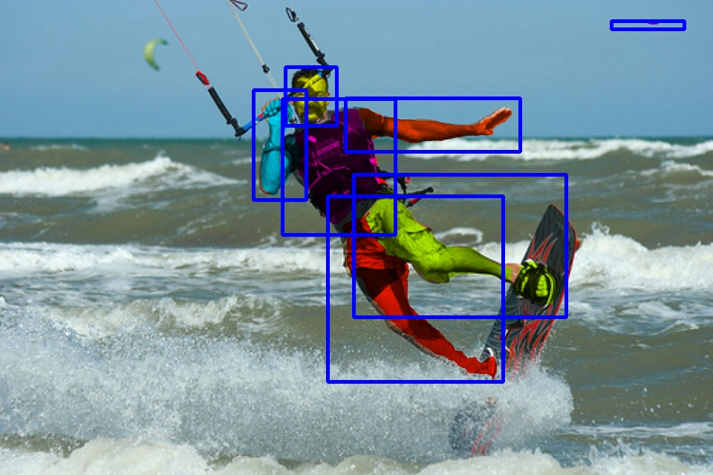
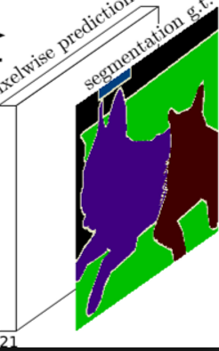
Trained FastMaskRCNN for body parts detection and segmentation
Classification
ResNet
RPN
Objectness:human/non-human
Segmentation
<number>

Slide 8
Thank you

